Slide 1
Ellington Public Schools Next Generation Accountability System
2016-2017 Report

Slide 2
Accountability Systems
Serve Important Purposes
Track progress
Help schools and districts make improvements
Show where support is needed most
Recognize successes
Promote transparency
Satisfy federal and state requirements

Slide 3
What changes were made to the accountability system?
Added several new indicators to underscore the importance of a well-rounded education
College – and Career- Readiness
Arts Access and Physical Fitness
Emphasized academic growth on state tests
Adjusted classification methodology to better represent overall school performance, target interventions and support, and refrain from “labels”

Slide 4
What are the 12 indicators?
Academic achievement status measured by state assessments
Academic growth
Assessment participation rate
Chronic absenteeism
Preparation for postsecondary and career readiness – coursework
Preparation for postsecondary and career readiness – exams
Graduation – on track in ninth grade
Graduation – four-year adjusted cohort graduation rate (all students)
Graduation – six-year adjusted cohort graduation rate (high needs)
Postsecondary entrance rate – all students (college enrollment)
Physical fitness
Arts access

Slide 6
A New Family of Index Scores
Accountability Index
The percentage of total possible points earned on all available indicators
Performance Index
The subject-specific index scores derived from state assessment results (Indicator 1)

Slide 7
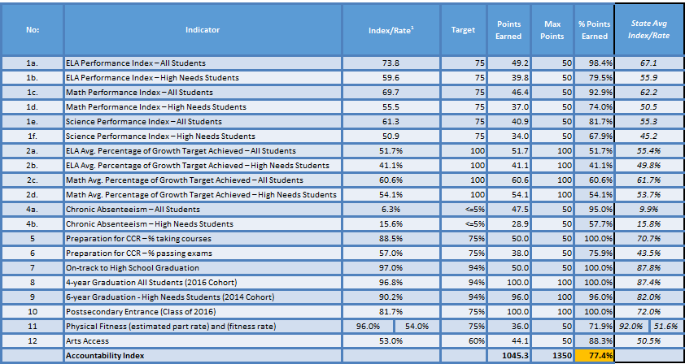
Ellington Public Schools District Report, 2016-2017
Notes:
Key Terms:
The percentage of total possible points earned on all indicators is the “Accountability Index”.
“Performance index” (SPI/DPI) will continue to refer to the index scores derived from state assessment results (Indicator 1). Note that only subject indexes will be provided.
These terms are now defined in Sec. 326 of Public Act 15-5.
Refer to the document “Using Accountability Results to Guide Improvement” for the methodology for each indicator.

Slide 8
Ellington Public Schools District Report, 2016-2017
“Achievement Gap” = gap size is substantially different from the average statewide gap in any subject area
“Graduation Gap” = gap size is substantially different from the average statewide gap
Notes:
A district’s gap size is the difference in “performance index” or six-year graduation rate between the Non-High Needs group of students, and the High Needs students.
Every school and district is expected to meet the 95% participation rate standard for the ALL Students group and the High Needs subgroup in ALL the tested subject areas (i.e., English Language Arts, Mathematics, and Science).

Slide 10
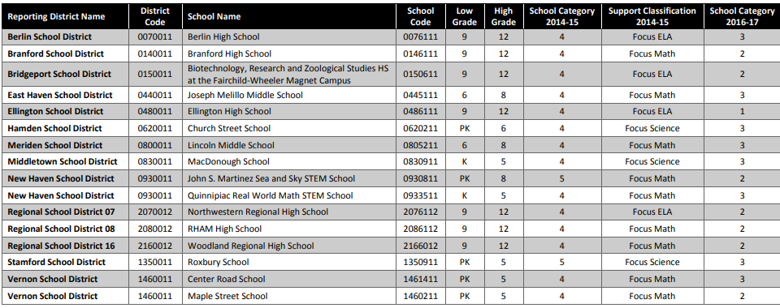
Focus Schools that are Exiting
Notes:
Ellington HS got off the Focus list

Slide 12
Ellington Schools Report, 2016-17
School Name | Accountability Index | Any Participation below 95%? | Achievement Gap? | Graduation Rate Gap? | Category?
Center Elementary School | 63.6 | No | Y- ELA | N/A | 3
Crystal Lake Elementary School | 62.3 | No | Y- ELA | N/A | 3
Windermere School | 71.4 | No | No | N/A | 2
Ellington Middle School | 68.0 | No | Y- ELA | N/A | 3
Ellington High School | 82.4 | No | No | No | 1
12
Notes:
Note if you have an identified gap (with more than 40 students going into that calculation) then you get -1 level.

Slide 13
Ellington Elementary Schools
Efforts to Increase Accountability Index Score
Curriculum and instruction are aligned with CCSS and the SBAC expectations
Teachers meet weekly with grade level teams and a literacy specialist to review reading data and plan small group instruction to target student need in and out of the classroom
All teachers participate in ongoing professional learning from the TC staff developers
Math interventionists meet with teachers to help plan instruction to improve math differentiation, for both remedial and enrichment
Literacy, special education teachers, and classroom teachers work together create achievement targets for students for all students not attaining grade level expectations (monitored through SRBI and Special Education both)
Students have comfort and familiarity with the Chromebooks through daily use
Grades 3-6 teachers work with Literacy Specialist and TC Staff Developers to build their SBAC knowledge on the assessment expectations and scoring rubrics, looking specifically at the scoring rubrics on the ELA portion of the assessment and turning those into “student-friendly” self-assessment tools. Teachers teach “test taking” as a reading genre in tested grades and use the TC test prep units
Grades 3-6 teachers use the test prep units and provide practice on SBAC interim assessments, both reading and math, and grade 5 for the NGSS

Slide 14
Ellington Middle School
Efforts to Increase Accountability Index Score
EMS Teachers have targeted SLO growth goals to improve in identified areas for increased SBAC performance in the area of ELA, math, and science
A schoolwide learning walk model that is closely linked to teacher led professional development, teacher led inquiry groups, and teacher evaluation.
The extended use of CSDE Interim SBAC Assessments in both ELA and math classrooms
The revision of scheduling SBAC testing based on the most recent research and the impact “when” students take assessments.
Intensive work in the area of NGSS to improve performance in the area of science
Ongoing curriculum work (including the development of new 7-12 continuums) in the area of ELA
ELA teachers are provided ongoing professional development and coaching support from the Literacy Specialist, Curriculum Supervisor, and TC Staff Developer to support instructional practices
The early review and initial re-design of the middle school math intervention programming and classroom curriculums
Eight week data cycles tracking growth for all students who are identified special education and or need of SRBI services
Four week data cycle/ review of all students progress using the Hands Up interdisciplinary teaming model
Monthly review and action planning for students with chronic absenteeism by EMS Student Support Services Team (principal, school counselors, attendance secretary, nurse, and school psychologist) .
The significant redesign of the physical education program using a personalized approach towards the preparation of the state fitness exam.
College Power programming at EMS to promote post secondary entrance

Slide 15
Ellington High School
Efforts to Increase Accountability Index Score
EHS teachers targeted SLO growth goals focused on improving student academic performance with at least one goal aimed to support students identified as a high need student
SRBI Team analyzed student PSAT/SAT data to identify and develop plans for students
Literacy specialist supported small group and reading instruction in English and Social Studies classrooms
English teachers are provided ongoing professional development and coaching support from the Literacy Specialist, Curriculum Supervisor, and Kate Roberts, a literacy consultant to support instructional practices in reading and writing
Math instructional specialist hired to support math instruction
Students are provided more scheduled time with flex blocks to support redo/retakes
English curriculum revision work to support students ability to demonstrate independence as a reader and to support SAT/PSAT reading expectations by:
Increasing reading stamina, engagement, and instruction
Aligning assessments and rubrics to content standards
Benchmark assessments in Social Studies and English are aligned to PSAT/SAT reading assessment texts and questions
Math curriculum revision work to support:
Vertical alignment and prioritization of standards 7-12 and a crosswalk between PSAT/SAT assessed standards and the curriculum
Aligning formative & summative assessments to standards
Developing detailed grading and feedback aligned to the standards
PSAT/SAT prep sessions offered after school in Fall & Winter

