Slide 1
Multiple Means of Representation Providing Access to Print Text Dr. Anya Evmenova
Notes:
In the last module we had an overview of UDL Guidelines and Checkpoints that support three UDL principles. Now, lets start getting a better understanding of how we can implement each of those principles in the classroom. I’ve mentioned at the very beginning that UDL is not all about technology. But since you are taking this course from the assistive technology program, I will focus specifically on how technology (low tech and high tech) can be used to support students with various abilities and needs.

Slide 2
Multiple Means of Representation
Notes:
So today we’ll talk specifically about multiple means of representation that support recognition networks. We will also focus this module on access to print or text or reading. Remember that Multiple Means of Representation principle includes three guidelines: (1) Provide options for perception; (2) Provide options for language, mathematical representation, and symbols; and (3) Provide options for comprehension. Representation within UDL is really about providing students different experiences to receive information.

Slide 3
Difficulties with Reading
Having gross and fine motor control difficulties
Have trouble sounding out unknown words/decoding
Read slowly, with no fluency; skip,
substitute, omit, and/or transpose
letters, words, syllables, and phrases
Inadequate vocabulary and background knowledge
Have poor comprehension
Lack of attention and motivation
Vision problems
Notes:
Students with and without disabilities in any given classroom might struggle with reading for a number of reasons. In fact, based on research, it is rare that a student struggles with just one of the potential barriers/weaknesses in reading. Thus, students might have difficulty with physical access to books. Many students with and without identified disabilities demonstrate weak decoding and fluency skills; inadequate vocabulary and background knowledge about the topic. All of those result in poor comprehension that also leads to the lack of attention and motivation. Struggling readers easily lose track of where they are reading and require several supports. In other words, there may be barriers due to sensory issues (or seeing printed text); physical issues (manipulating printed text), and learning issues (understanding and processing printed text).

Slide 4
Multiple Means of Representation Guideline 1: Provide options for perception
Notes:
So let’s start with Guideline 1 under the multiple means of representation. It calls to provide options for perception.

Slide 5
Text-to-Speech
Text-to-speech reading programs
ReadOutLoud – ehighlighters, dictionary, voice options, text-to-speech.
NaturalReader – text-to-speech, converts printed text into digital text.
Built-in readers in PDF, Word
Multiple apps
Optical Character Recognition (OCR) programs
WYNN ($595) - http://www2.freedomscientific.com
Kurzweil (~$1,495/Free trial) - www.kurzweiledu.com
Scan and Read Pro ($149/Free trial) - www.readingmadeez.com
Notes:
For many struggling readers, text-to-speech programs offer support for decoding, reading fluency, and even comprehension. Text-to-speech programs read text from a document, web page or email aloud using a synthesized or computer voice. There are two types of text-to-speech programs. The text-to-speech reading programs read aloud text that is already in electronic format. We will talk more about all these examples in a little bit. The second type is a so-called Optical Character Recognition or OCR program that allows scanning printed pages and converting them into electronic text. Some examples of such programs include WYNN, Kurzweil – both are great/complex programs but are very expensive. Scan and Read Pro is a little more affordable. All these programs have the same features as the first group of tools, but converting text from print to digital format is what sets them apart.

Slide 6
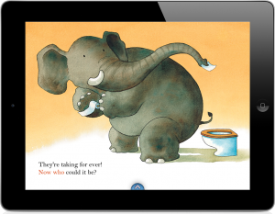
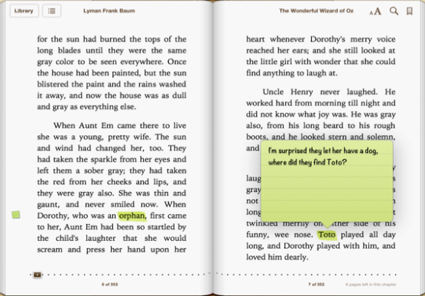
Important Reading Features
Text-to-Speech
Synchronized Highlighting
Search Text
Page Navigation
Bookmarking
Note-taking
Display Images; Alternate Text
Change font
Change Voice /Speed/Languages
Notes:
Text-to-speech programs are especially helpful to those who are better listeners than readers. Besides reading text out loud, text-to-speech programs and mobile apps might offer additional supports. For example, text can be highlighted for better tracking – it is called dynamic highlighting when each word, phrase, or sentence (depending on user’s preferences) is highlighted in yellow (or any other color), while they are being read aloud. It is important for programs and apps to have page navigation and book marking feature, so the user can navigate through the digital book. Many tools allow digital note-taking and searching text to make them feel more like printed books. It’s very important for the programs to display images and recognize alternative text labels describing images for those with visual impairments. Being able to change font, background, voice, and speed are also very important features for UDL environments.

Slide 7
Built-in Text-to-Speech
Speak feature in Microsoft Word (2010 and higher)
Add Speak to Quick Access Toolbar
Read Out Loud feature in Adobe Acrobat
View >> Read Out Loud
Speak Selection on iPhones/iPads
Settings >> Accessibility >> Vision
Notes:
Many platforms these days have text-to-speech feature built-in. You can find “Speak” text-to-speech feature available in Microsoft Word; “Read Out Loud” feature in PDF, and “Speak selection” feature in mobile devices. All of these read out loud the selected text. Speak selection in the iPads even allow dynamic highlighting.

Slide 8
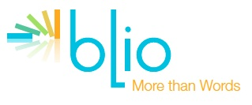
Mobile Applications
Blio App by K-NFB Reading technology Inc. (Free*)
Multiple reading views, dynamic highlighting, word definitions, full color display
GoodReader by Good.iWare Ltd ($4.99)
Air-Turn Bluetooth page turner, note taking, sign PDF documents, password protect files
SpeakIt App by Future Apps Inc. ($1.99)
Reads any document with by selecting the text you want to read or listen to
*NOTE: Voices available for purchase!
Notes:
There is also a myriad of mobile applications that offer text-to-speech capabilities. Here are just a few of them. All of them offer page navigation and book marking features. Blio also offers definitions for words and dynamic highlighting. Good Writer has extensive note-taking capabilities. SpeakIt! reads emails, documents, web pages, etc.

Slide 9
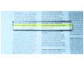
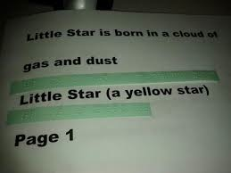
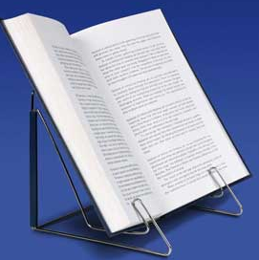
Low Tech Solutions
Colored transparency sheets
Line guides
Bar magnifiers
Adapting books
Wiki stix, puff paint, etc.
Book holders
1.1 Offer ways of customizing the display of information
Notes:
When dealing with the hard paper version of the text, it is possible to customize the display of information with such low-tech tools as color transparency sheet (put over the page to enhance the contrast). Line guides provide tracking. You can make them out of absolutely anything. Great line guides can be made out of tissue box cardboard (the cutout becomes the line guide). Bar magnifies work the same way but they make text within the window bigger. It’s great for those with sensory impairments. But it is also great for focusing learners’ attention. Books can be adapted in multiple different ways with wiki stix, puff paint and so on to make them more accessible for students with visual impairments as well as those who need sensory stimulation. Book holders can help those with physical challenges as well as other students who get distracted when they have to look down to read the text and then look up to the board to see the directions.

Slide 10
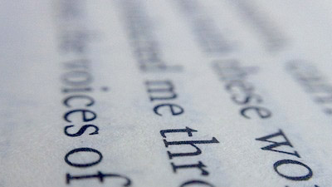
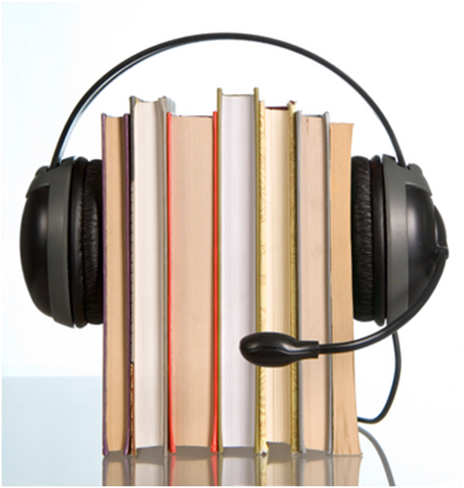
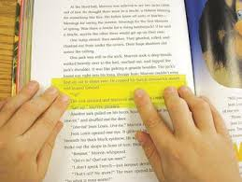
Low Tech Solutions
Enlarged print or text produced in Braille
Books on tape
Eye lighter
Highlighting tape
1.1 Offer ways of customizing the display of information
Notes:
Texts produced in large print, braille, or audio recordings such as books on tape offer a low-tech solution to students’ needs especially those with visual impairments. Low tech solution can be as simple as using a copier to enlarge regular print text to large print text. Hearing a book on tape can help students feel and see words on their pages. The eye lighter, which can be similar to a line guide, can help maintain a readers focus while reading.

Slide 11
Built-in Features
In various programs and platforms
Change Font, Background Colors
High Contrast (Invert Colors on Mac and iPad)
Magnifier (Zoom on Mac and iPad)
Windows (Start >> Control Panel >> Ease of Access)
Mac (Apple >> Preferences >> Accessibility)
iPads (Settings >> Accessibility >> Vision)
SMALL
MEDIUM
LARGE
1.1 Offer ways of customizing the display of information
Notes:
Obviously all text-to-speech programs and mobile applications allow changing the font size, font color, background color and so on. In addition, accessibility features built-into all computers and mobile devices offer additional ways for customizing the display of information. Thus, you can change the contrast to make text more accessible for those with visual impairments. You also can use the magnifier or zoom feature to enlarge the text on the screen.

Slide 12
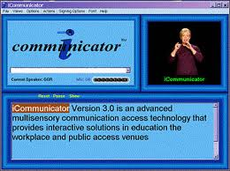
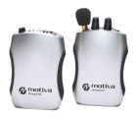
Auditory Input
Closed captions
ASL Dictionaries illustrated and interactive 3D sign language dictionaries.http://www.signingapp.com/ssd_desktop.html
iCommunicator ($4,999) http://www.icommunicator.com
Speech to text, speech/text to video-sign language, speech/text to computer generated voice.
FM Amplification Systems
1.2 Offer alternative for auditory information
Notes:
In terms of offering alternative for auditory information, the first thing that comes to mind is captions. Many video databases (which we will talk about later) offer videos with captions. Teachers might also be interested in incorporating some sign language into their classroom routines even if there are no students with hearing impairment. I have recently been in a very large inclusive middle school classroom in DC with 35 students. The only way the teacher could keep control of such a large classroom was to use the signs. Here, I have a great link to many resources for sign language dictionaries. iCommunicator Software uses voice recognition to provide captioning and sign language simultaneously. It’s a fascinating program, just like it’s price. One last thing – usually FM amplification systems are used to amplify the teacher’s voice for students with hearing impairment. Well, some recent research showed, that amplification systems also improve attention skills and following directions for students without disabilities.

Slide 13
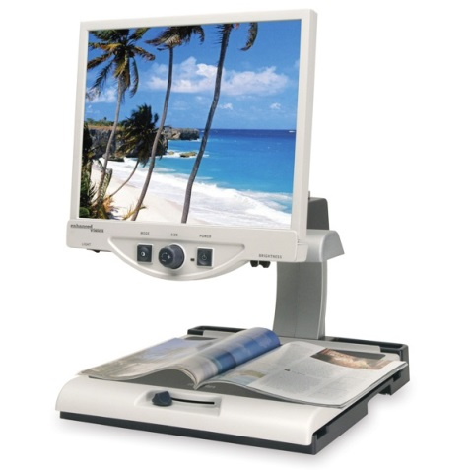
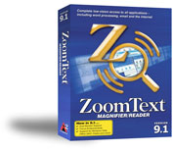
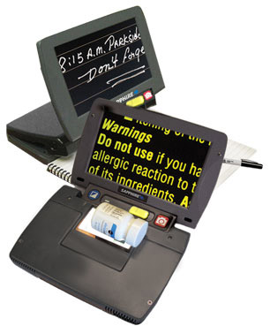
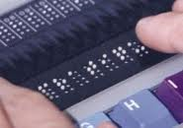
Assistive Technology Options
Closed-Circuit Televisions (CCTVs)
Portable magnifiers
Screen magnifiers
E.g., Zoom Text
Screen readers (e.g., Narrator in Windows; Voice Over on iPad)
E.g., JAWS
Refreshable Braille Displays
1.2 Offer alternative for visual information
Notes:
For some students, it will not be enough just to incorporate UDL principles into the lessons. They might require additional assistive technology tools in order to successfully access the text. For example, students with visual impairments and those who are blind might need such tools as Closed-Circuit Televisions or portable magnifiers to enlarge print text. Screen magnifiers can be used to enlarge the electronic text on the screen. Screen readers are programs that are similar to text-to-speech tools. The only difference that screen readers read absolutely everything on the screen, not just text in the document. Other technologies for individuals with sensory disabilities include refreshable braille displays that allow users read digital text in braille-ready format. These are very special assistive technologies used by individuals with sensory impairments. We have the whole class covering this topic in our program. So I will not go into any detail about these. This slide is just FYI.

